Slide 1

Design Theory • Year 1
Who Are You Talking To?
Audience, Personas,
Context & Medium
Good design choices start before the software opens.
Notes:
Welcome students and frame today as a practical decision-making lesson, not a software lesson.
Before we choose typefaces, colours, photos, layout, or format, we need to ask: Who is this for? What should they understand, feel, or do? Where will they see it?
Image: AI-generated classroom illustration. No external visual source used.

Slide 2
Lecture roadmap
Today’s path
Three questions designers ask before making visual choices.
1. Audience & intended message
2. Design personas
3. Context & medium
Who needs to understand this? What should they think, feel, or do?
How can a realistic audience profile guide design decisions?
Where will this design live, and how does that change what works?
Notes:
Emphasize that the topics connect: audience informs persona; persona is tested against context and medium.
Opening question: “Think of a poster, app, sign, or social post that confused you. Was the problem the message, the audience, or the place you saw it?”
Distinguish between the Intended Message (what the designer encodes) and the Perceived Message (what the audience decodes).
Understand why graphic design is a two-way form of communication, not just self-expression.
Identify potential visual "noise" that distorts a message.
Understand the concept of the User Persona pioneered by Alan Cooper.
Recognise why "designing for everybody means designing for nobody."
Learn how to synthesize demographic and psychographic data into actionable design criteria.
Apply Marshall McLuhan’s media theory ("The medium is the message") to modern graphic design.
Contrast physical (environmental, print) context with digital (screen, UX/UI) context.
Evaluate how viewing distance, lighting, and platform constraints dictate visual hierarchy.
To recap: design communication so the intended audience can find, understand, and use information; user-centred design sources emphasize designing around user needs.

Slide 3

Design Theory • Year 1
Audience and Message
Notes:
Begin by asking the class: "Is graphic design art?" Let them answer briefly before setting the foundation.
Design vs. Fine Art:
Fine art can be self-referential or open to infinite interpretation.
Graphic design, however, must fulfill a purpose: it is communication with intent.
If your audience does not decode the message as intended, the design has failed—regardless of how aesthetically pleasing it looks.

Slide 4


1 • Audience & Intended Message
Encoding and Decoding
Audience is the group that needs to understand, use, or respond to the design.
The Designer (Encoding)
The Audience (Decoding)
Designers translate raw concepts into visual messages using typography, colour, composition, and cultural symbols.
Receivers interpret visual cues through the lens of their unique experiences, values, and cultural context.
Every choice carries hidden assumptions and intended meaning created by the sender.
If the decoded meaning differs from the intent, visual communication has failed.
Notes:
The Designer
Encoding: As designers, we construct visual messages using color palettes, typography, spatial layout, imagery, and cultural symbols.
The Audience
Decoding: The audience interprets those visual cues based on their cultural background, personal experiences, language, and context.
Why the Audience Matters
• Design is communication
• Every design has a target audience
• Good design solves audience needs not designer preferences
Interactive Question/Activity:
Ask: Who is the audience for a campus event poster?

Slide 5
1 • Audience & Intended Message
A design is not “for everyone”
Audience-Centred Design
Audience: who receives the message
Message: what you want them to think, feel, or do
Different audiences interpret visuals differently
Design decisions change when the audience changes.
Intended message = the main idea + action you want the audience to take.
Notes:
When students say, ‘I want it to appeal to everyone,’ gently push back. In professional design, ‘everyone’ is too vague to guide choices. The more clearly we define the audience, the more confident our design decisions become.
Question: What would change if the same message were designed for: a teenager, a parent, a new Canadian, or a business sponsor?
Example: A campus event poster for first-year students should not look or read the same as a sponsorship proposal for local businesses.
Key accuracy check: Canada.ca defines plain language as wording, structure, and design that help the intended audience find, understand, and use information. This supports the point that message clarity and audience fit are design concerns, not just writing concerns.

Slide 6
1 • Audience & Intended Message
Audience changes design choices
The same information can require a different visual voice.
Language
plain, formal, playful, technical
Visual tone
friendly, urgent, premium, calm
Hierarchy
what the viewer sees first, second, third
Accessibility
contrast, type size, captions, alt text
Cultural fit
symbols, assumptions, humour, references
Notes:
Audience awareness does not mean stereotyping. It means making evidence-informed guesses, then checking them. Good designers ask: what might this audience need to feel confident, included, safe, or motivated?

Slide 7

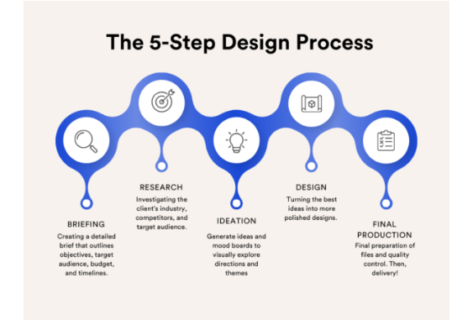
Audience-Centred Design
Intentional Cues
Eliminating Noise
Shared Codes
Notes:
Successful communication requires shifting focus from internal preference to audience reception.
Intentional Cues: Select typography and colours that reflect audience literacy.
Eliminating Noise: Remove confusing symbols and visual clutter. Visual noise can be physical (poor contrast, tiny text size, bad printing) or cultural (using symbols or slang that the target demographic finds confusing or offensive).
Shared Codes: Use cultural metaphors understood by your specific demographic.

Slide 8

Design Theory • Year 1
Creating Design Personas
Humanizing user research to guide decision-making
Notes:
A persona is not a random character biography. It is a design tool. It turns ‘students’ or ‘customers’ into a person-like summary that helps you make decisions.
Question: What is the danger of designing only for yourself?
Expected responses: personal bias, missing accessibility needs, using references others do not know, making the design too trendy or too confusing.

Slide 9
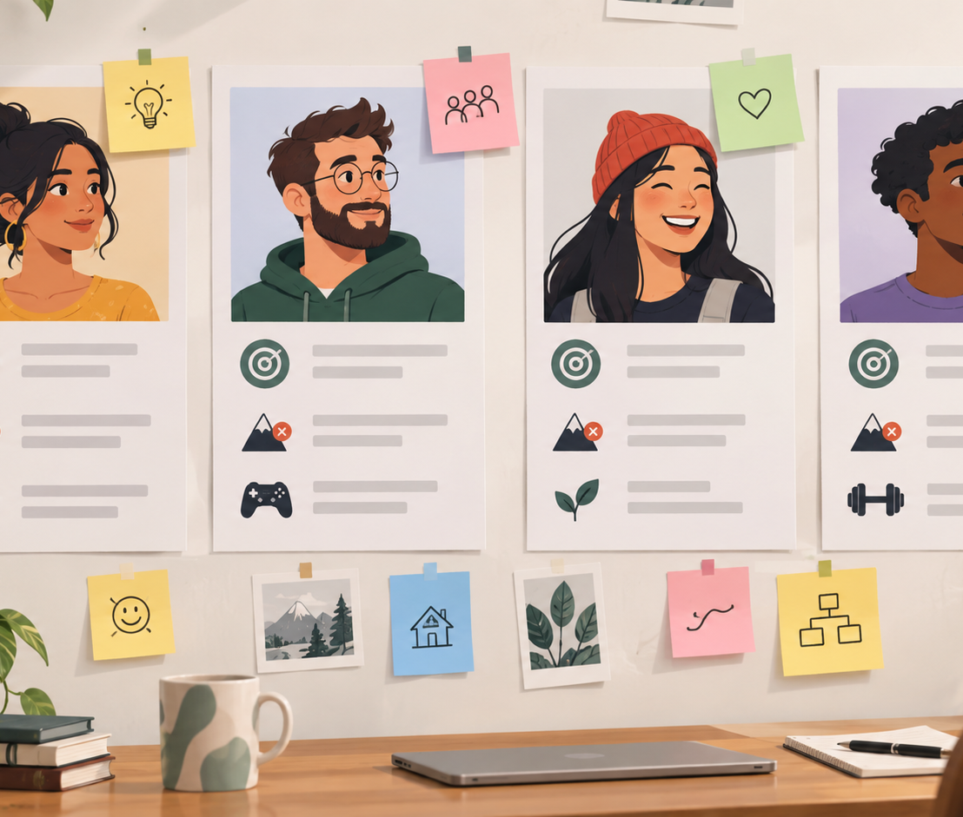
Personas make the audience easier to design for
2 • Design Personas
A persona is a fictional but realistic profile of a target user or audience member.
Why they help
focus decisions on people, not personal taste
reveal possible barriers
help teams discuss trade-offs
make abstract audiences memorable
Notes:
Personas make the audience easier to design for
A persona is a fictional but realistic profile of a target user or audience member.
Why they help
READ FROM SLIDE
Personas are tools, not facts. They should be grounded in research or careful assumptions and revised when you learn more.
• Personas are fictional, research-based representations of users
• Help build empathy
• Support design decisions
Source accuracy check: Nielsen Norman Group describes a persona as a fictional yet realistic description of a typical or target user and says personas can support empathy, memorability, prioritization, and design decisions.

Slide 10



2 • Design Personas
Why Personas Matter
Build Empathy
Establish Focus
Align Teams
Transform abstract user data into concrete archetypes, allowing designers to view choices from a real perspective.
Eliminate the "elastic user." Designing for a specific somebody prevents generic solutions that satisfy no one.
Create a shared baseline for clients, copywriters, and designers, ensuring everyone builds for the same target.
Personas are tools, not facts. They should be grounded in research or careful assumptions and revised when you learn more.
Notes:
Why Personas Matter
READ FROM SLIDE
Personas are tools, not facts. They should be grounded in research or careful assumptions and revised when you learn more.
Source accuracy check: Nielsen Norman Group describes a persona as a fictional yet realistic description of a typical or target user and says personas can support empathy, memorability, prioritization, and design decisions.

Slide 11
Designing for One
1
Primary Persona
A useful design persona is specific — but not creepy
Include
Avoid
goal, task, need, motivation, barrier, context, comfort level, accessibility consideration
stereotypes, fake precision, private details, irrelevant backstory, “everyone is the same” assumptions
These details help you decide format, tone, content, and hierarchy.
These details can lead to shallow or biased design choices.
Keep details that affect design decisions. Leave out details that do not matter.
Notes:
Designing for One
1 Primary Persona - A useful design persona is specific — but not creepy
Include – READ FROM SLIDE
Avoid – READ FORM SLIDE
Avoid Generic Compromise
Attempting to satisfy every potential demographic leads to cluttered layouts, diluted messaging, and weak visual hierarchy.
Emphasize ethics and usefulness. Persona details should be relevant and respectful. If a detail does not influence the design choice, it probably does not belong.
Summary: Identify one primary persona whose needs must be met, then accommodate secondary personas without compromising the core message.
Keep details that affect design decisions. Leave out details that do not matter.
Interactive question: “Which is more useful for designing a transit poster: ‘Jordan likes dogs’ or ‘Jordan has 8 seconds to read the sign while transferring buses’? Why?”
Source used: NN/g personas guidance and user-centred design principles.

Slide 12




Building a Design Persona
4. Apply
2. Patterns
Use the persona to test typography, color, and visual hierarchy.
Identify recurring goals, frustrations, and visual habits.
1. Research
3. Archetype
Gather demographic data, interview notes, and behavioral insights.
Synthesize research into a realistic single persona profile.
Notes:
• Name and photo
• Goals and motivations
• Behaviours and challenges
• Design needs
• Ava, 19, first-year college student
• Uses mobile first
• Needs quick information
• Overwhelmed by clutter

Slide 13
2 • Design Personas
Example of a lightweight persona
Create a poster for a first-year design workshop: “How to Ask for Feedback.”
Persona sketch
Questions
1. What would make this student ignore the poster?
2. What would make them trust it?
3. What design choice changes because of this persona?
• Ava, 19, first-year college student
• Uses mobile first
• Needs quick information
• Overwhelmed by clutter
Notes:
Students work in pairs. They have 3 minutes to fill in a lightweight persona, then 2 minutes to connect it to a design decision.
Suggested facilitation: Circulate and ask: “What did that persona detail change?” Encourage students to move from labels to design decisions: larger type, less jargon, warmer tone, clearer deadline, image of peer-to-peer critique, QR code, accessible contrast.
Source used: NN/g personas and IxDF persona guidance: personas guide ideation and reduce design complexity when used carefully.

Slide 14

Design Theory • Year 1
Context & Medium
How environment and channel shape perception
Notes:
Context and medium are often where beginner designs fail. A design can look beautiful on a laptop screen but fail on a hallway wall, on a phone outdoors, or in a rushed email inbox.
The Medium is the Message
— Marshall McLuhan (1964)
The channel carrying your work alters its trust, tone, and processing speed.
Print commands authority;
mobile demands brevity.

Slide 15
3 • Decoding Context & Medium
The same design does not work everywhere
Context is the situation of use. Medium is the channel or format carrying the message.
Context asks:
Where are they?
What are they doing?
How much time do they have?
What else competes for attention?
Medium asks:
poster
phone
website
sign
email
slide
package
motion
print
social post
Design for the moment of encounter.
Notes:
Context is the situation of use. Medium is the channel or format carrying the message.
• Context = where, when, and why audience sees design
• Medium = channel carrying message
Where did you last see a design that looked good but was hard to use?
Source accuracy check: NN/g’s omnichannel guidance recommends designing for each channel’s unique strengths and role. NN/g UX research guidance also distinguishes natural or near-natural use from scripted or decontextualized use.

Slide 16
3 • Decoding Context & Medium
Physical vs Digital Mediums
Physical Environment
Digital Environment
Variables:
Viewing distance,
lighting,
physical dimensions,
material substrate.
Variables:
Screen aspect ratio,
ambient mode,
variable viewports,
short attention spans.
Design Impact:
High contrast requirement,
large type scale for billboards,
tactile stock selection for luxury branding.
Design Impact:
Responsive layouts,
immediate visual hooks,
accessible touch targets,
system fonts.
Notes:
Medium is not just file size. It changes how much detail people can process, what interaction is possible, what accessibility checks matter, and what production constraints exist
• Environment affects attention
• Device affects readability
• Timing affects relevance
Accessibility note:
For digital work, connect briefly to Web Content Accessibility Guidelines (WCAG) principles.
1. Perceivable: Content must be presented in ways that users can perceive through their senses.
2. Operable: User interface components and navigation must be operable
3. Understandable: Content and interface operation must be understandable.
4. Robust: Content must be robust enough to be interpreted reliably by a wide range of user agents
For print/signage, translate the same idea into
contrast,
legibility,
viewing distance, and
clear hierarchy.
Question: Would a highway billboard and Instagram post look the same?

Slide 17
3 • Decoding Context & Medium
Medium changes hierarchy, scale, and reading behaviour
A social post, poster, and slide may share content, but they should not be identical.
Phone/social
Poster/sign
Presentation slide
tiny screen
fast scroll
thumb interaction
short copy
distance
movement
large type
few words
shared space
speaker support
visual anchor
not a handout
Design question:
What must be noticed first?
Design question:
What must be noticed first?
Design question:
What must be noticed first?
Prompt: How would “Portfolio Show — Friday 6 PM” change across these three media?
Notes:
Prompt: How would “Portfolio Show — Friday 6 PM” change across these three media?
For a phone post, poster, and slide, which information should be the largest: date, title, image, location, QR code, or sponsor logo? Why?
The Web Content Accessibility Guidelines (WCAG) are organized around four core principles that ensure digital content is accessible to people with disabilities and usable by all users. These principles, often referred to by the acronym POUR, guide the creation, evaluation, and improvement of web content.
1. Perceivable: Content must be presented in ways that users can perceive through their senses. This means information should not be invisible to any user, including those with visual, auditory, or other sensory impairments. Examples include providing text alternatives for images, captions for videos, and adaptable content that can be resized or presented in different formats. Perceivable content ensures that all users can access the information regardless of sensory limitations.
2. Operable: User interface components and navigation must be operable, meaning users can interact with them effectively. This includes ensuring that all functionality is accessible via keyboard navigation, voice commands, or other assistive technologies. It also involves providing enough time for users to read and interact with content, avoiding design elements that could trigger seizures, and making navigation consistent and predictable.
3. Understandable: Content and interface operation must be understandable. Users should be able to comprehend the information and know how to interact with the website. This principle covers clear instructions, consistent design patterns, readable text, and predictable functionality. It also addresses cognitive accessibility, helping users with learning disabilities or limited experience with technology.
4. Robust: Content must be robust enough to be interpreted reliably by a wide range of user agents, including current and future technologies, as well as assistive devices like screen readers or braille displays. This ensures that web content remains accessible as technology evolves and across different platforms and devices.
Source thewcag.com
Sources used: NN/g channel/context guidance; W3C WCAG overview.

Slide 18
3 • Decoding Context & Medium
Use a context decoder before finalizing
This is a quick professional check for whether the design fits real life.
Viewer state
rushed, relaxed, confused, excited, anxious?
Environment
quiet, noisy, bright, dark, online, hallway, outdoors?
Time available
2 seconds, 10 seconds, 2 minutes, later review?
Action path
scan QR, register, ask staff, remember, buy, donate?
Constraints
size, file format, accessibility, brand, budget, production?
Professional habit: test the design in the medium, not only on your working screen.
Notes:
This decoder is a bridge between beautiful composition and effective communication.
Designers often discover problems only when they test in context:
print the poster,
view the post on a phone,
stand back from the sign, or
show the slide from the back of the room.
Interactive quick check: Ask students to choose one decoder question and apply it to a campus event poster for “Portfolio Show — Friday 6 PM”.
Source used: user-centred design and context-of-use guidance from NN/g, Canada.ca, Canadian Digital Service, and IxDF.

Slide 19
Practice synthesis
Put it together: from brief to design decision
One scenario, three lenses.
Brief: Design a digital poster for a free mental health drop-in session for first-year students.
Audience & message
Persona
Context & medium
Who needs this, and what should they feel safe doing?
What student barrier or motivation will guide the design?
Where will they see it (phone, LMS, hallway screen) and what changes?
Write one design decision and explain which lens led to that choice.
Notes:
Activity
Instructions: Give students 2 minutes individually, 2 minutes in pairs, then gather 3 examples from the room.
Suggested responses:
warmer non-clinical language;
no crowded copy;
clear “drop in,
no appointment” message;
accessible contrast;
image that suggests support without clichés;
Instructor caution: avoid having students design from stereotypes about mental health. Keep the focus on barriers and respectful communication.

Slide 20
Wrap-up
Three questions to keep using
These questions belong in every design critique.
1
2
3
Who is this for?
What should they understand or do?
Where and how will they encounter it?
Audience
Message
Context + medium
Good designers can explain the reason behind a visual choice.
Notes:
As you move into projects, we will keep asking you to defend your choices. ‘I like it’ is a starting point, but a design rationale connects the choice to audience, intended message, context, and medium.
Question: Which question do you think you will forget most often when designing?

Slide 21
Lecture roadmap
Key Takeaways
1. Audience & intended message
2. Design personas
3. Context & medium
Design is intent.
Know the audience
Define the message
Personas build focus.
Use them
Context determines form.
Design for them
Audience informs persona; persona is tested against context and medium.
Notes:
Design is intent. Personas build focus. Context determines form.
Distinguish between the Intended Message (what the designer encodes) and the Perceived Message (what the audience decodes).
Graphic design is a two-way form of communication, not just self-expression.
Create a User Persona.
"designing for everybody means designing for nobody."
Apply Marshall McLuhan’s media theory ("The medium is the message") to modern graphic design.
Contrast physical (environmental, print) context with digital (screen, UX/UI) context.
Evaluate how viewing distance, lighting, and platform constraints dictate visual hierarchy.
Audience informs persona; persona is tested against context and medium.
To recap: design communication so the intended audience can find, understand, and use information; user-centred design sources emphasize designing around user needs.

Slide 22
Sources checked
Sources consulted
All lecture concepts were checked against these sources.
Canada.ca Content Style Guide — plain language and audience: https://design.canada.ca/style-guide/
Canada.ca Designing for Canada.ca — design for people / user needs: https://design.canada.ca/
Canadian Digital Service — user-centred design: https://digital.canada.ca/user-centred-design/
Nielsen Norman Group — Personas: Study Guide: https://www.nngroup.com/articles/personas-study-guide/
Nielsen Norman Group — Optimizing for Context in Omnichannel UX: https://www.nngroup.com/articles/context-specific-cross-channel/
Nielsen Norman Group — When to Use Which UX Research Methods: https://www.nngroup.com/articles/which-ux-research-methods/
W3C WAI — WCAG 2 Overview: https://www.w3.org/WAI/standards-guidelines/wcag/
Interaction Design Foundation — User-Centred Design: https://www.interaction-design.org/literature/topics/user-centered-design
Interaction Design Foundation — Personas: A Simple Introduction: https://www.interaction-design.org/literature/article/personas-why-and-how-you-should-use-them
Note: Activities and classroom examples were created for this Year-1 Canadian college context. Generated images are original AI visuals created for this deck.
Notes:
Sources slide. Use if students ask where the lecture framework came from.
Canada.ca Content Style Guide — plain language and audience: https://design.canada.ca/style-guide/
Canada.ca Designing for Canada.ca — design for people / user needs: https://design.canada.ca/
Canadian Digital Service — user-centred design: https://digital.canada.ca/user-centred-design/
Nielsen Norman Group — Personas: Study Guide: https://www.nngroup.com/articles/personas-study-guide/
Nielsen Norman Group — Optimizing for Context in Omnichannel UX: https://www.nngroup.com/articles/context-specific-cross-channel/
Nielsen Norman Group — When to Use Which UX Research Methods: https://www.nngroup.com/articles/which-ux-research-methods/
W3C WAI — WCAG 2 Overview: https://www.w3.org/WAI/standards-guidelines/wcag/
Interaction Design Foundation — User-Centred Design: https://www.interaction-design.org/literature/topics/user-centered-design
Interaction Design Foundation — Personas: A Simple Introduction: https://www.interaction-design.org/literature/article/personas-why-and-how-you-should-use-them

